Slide 1
Wealth Watch
Personal Financial Tracker

Slide 2
Creative Minds
Joseph Obeghe
Pratyush Srivastava
Trudy-Ann Campbell
Esther Odesanya

Slide 3
TABLE OF CONTENTS
001
002
003
004
Project Brief
Development Update
Code Showcase
Project Demo

Slide 4
Project Brief
A personal financial tracking software solution
The goal of this software is to help users keep track of their wealth, daily spending, monthly subscription costs, outstanding debt, stock portfolio, and other financial activities.
By providing users with these valuable insights, they can make better financial decisions and take control of their financial futures.

Slide 5
Development Update
Wealth Watch
Stack based Linked List
Data Storage and Retrieval
Managing the Linked List
Sorting based on different needs
Visual Update to User UI

Slide 6
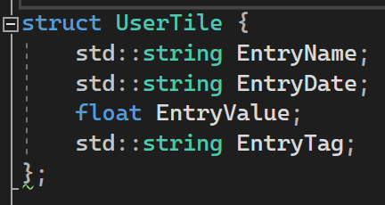
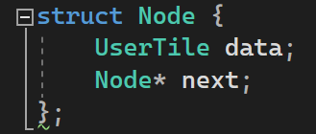
Stack based Linked List
Based on Object Oriented Design, we based our primary datatype is the following Struct:

Slide 7
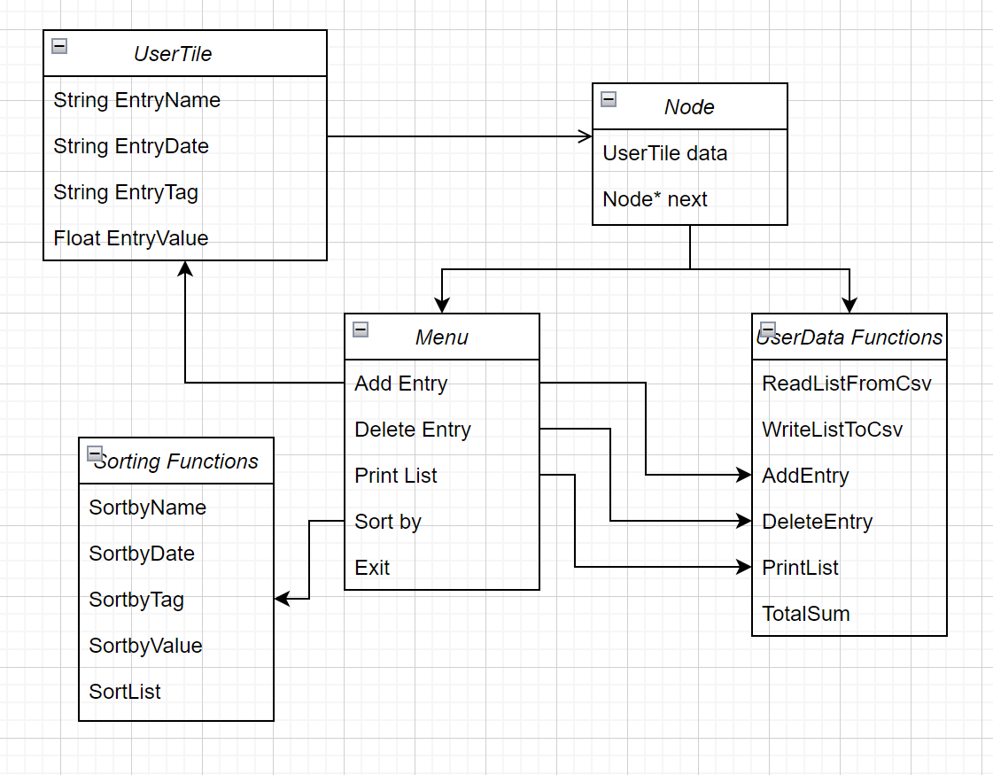
Class Diagram

Slide 8
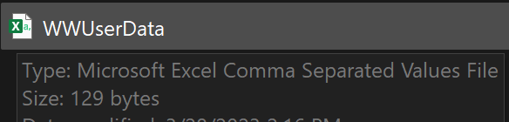
Data Storage
We’re using a general CSV format file to keep the data simple to read, write and store.
The csv is a versatile format which also allows the user to export it into other programs if needed.

Slide 9
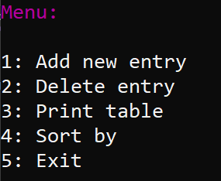
Managing the Linked List
In order to manage the list we’ve created the following menu:

Slide 10
Menu Options
Add New Entry
Delete Entry
A
D
Print Table
Sort by
P
S
we’ll look at each option individually

Slide 11
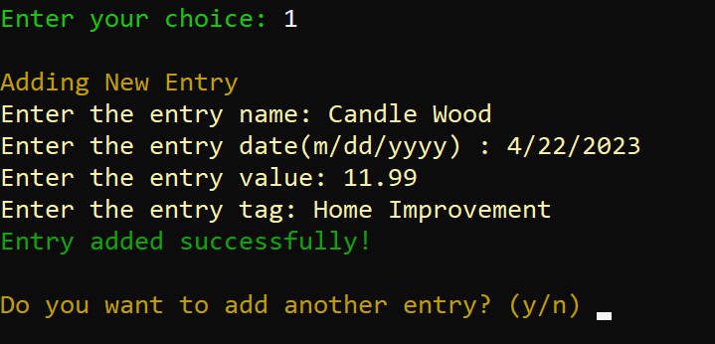
Add New Entry
Allows user to populate the struct linked list
Also allows users to add more entries if they want

Slide 12
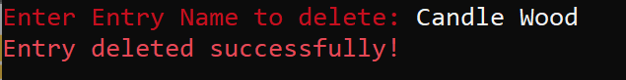
Delete Entry
Allows user to delete an entry
Searches through the linked list to find the data entry with name then deletes it.

Slide 13
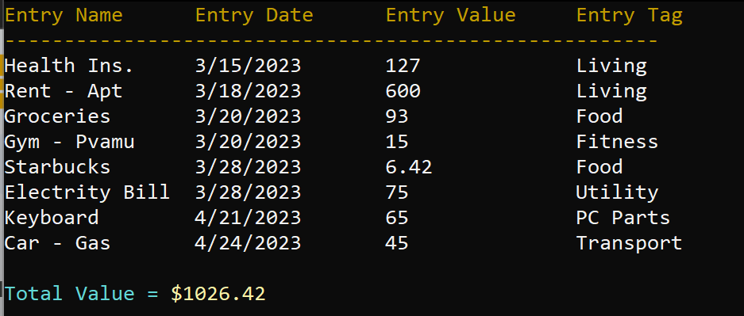
Print Table
Prints the Entire table of information

Slide 14
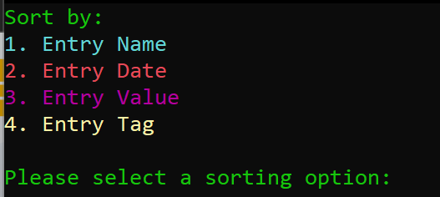
Sort by
Offers users the choice of sorting their list based on different values

Slide 15
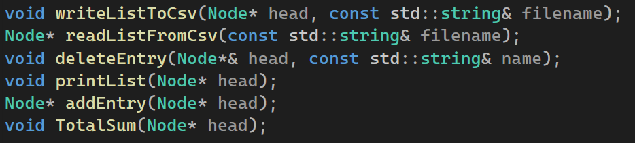
FUNCTION OVERVIEW
writeListToCsv/readListFromCsv - For Storage using Csv
deleteEntry - Searches through the linkedlist for data, if found - deletes.
printList - Prints current linked list
addEntry - Adds new UserTile
TotalSum - calculates total value of items on the list

Slide 16
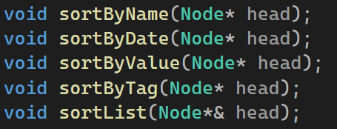
SORTING OVERVIEW
Sort by Name/Date/Value/Tag - uses bubble sort to sort the linked list based on the chosen data.
Sort List - the main function that is called to select the aforementioned sort category.

Slide 17
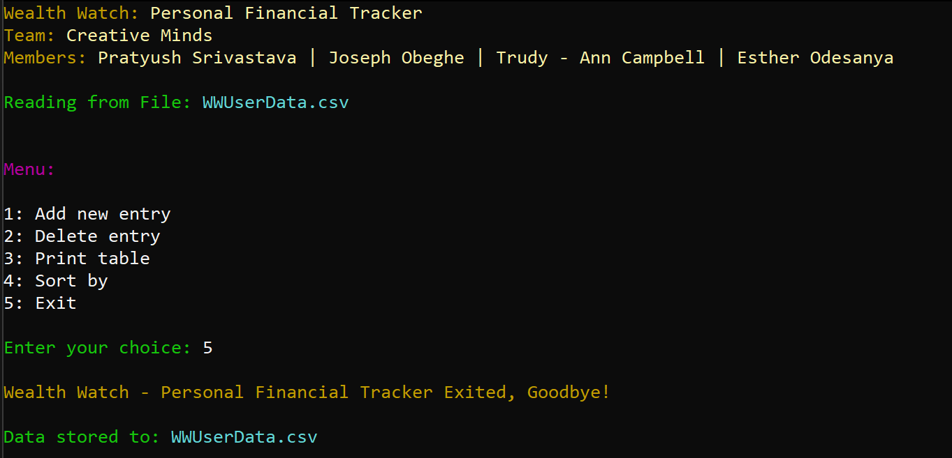
USER UI OVERVIEW

Slide 18
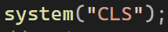
USER UI (cont.)
Setting Console Text Color using Console Handler
Using System call “CLS” for clearing log for better visual clarity

Slide 19
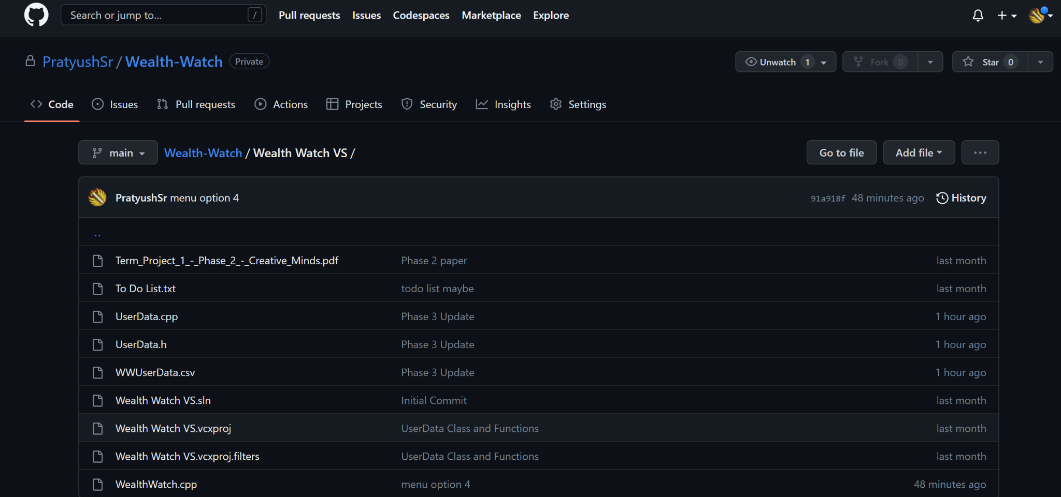
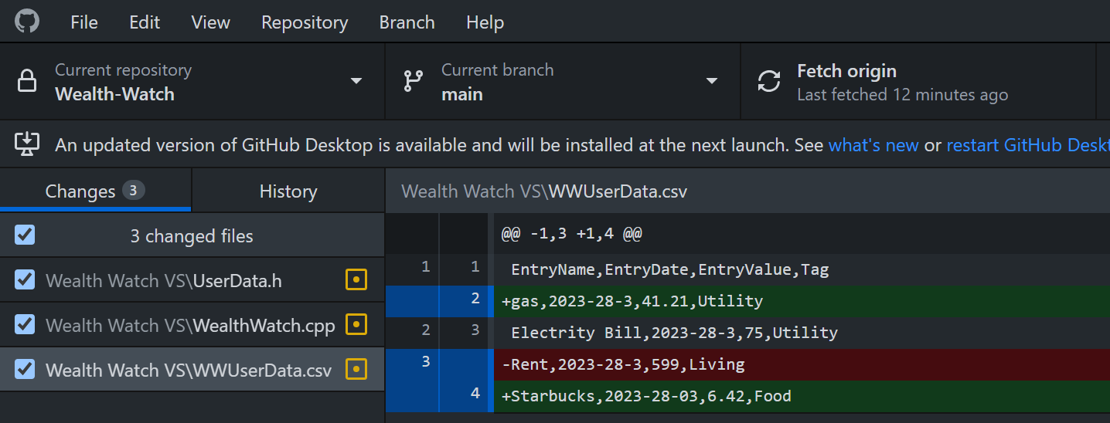
Source Control
GitHub

Slide 20
Demo
Wealth Watch

Slide 21
TIMELINE
Feb 28
March 14
March 28
April 11
April 25
Initial Project Proposal
Repository Setup and 1st iteration
Mid Semester Update and Presentation
Finalizing the project and Report
Final presentation demo and report

Slide 22
Q&A/Code Explanation if requested :)
Wealth Watch

Slide 23

Thank you!

